Slide 1
IIR Filter
DISCLAIMER:- THIS PPT IS FOR REFERENCE PURPOSE ONLY. PLEASE REFER TEXT BOOK FOR DETAILED STUDY.

Slide 2
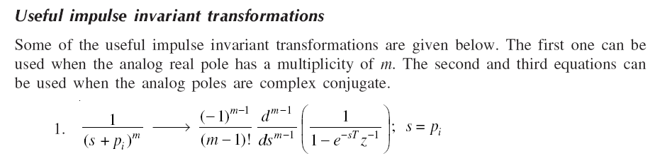


Slide 3
The impulse invariant method is obtained by
a. Sampling the impulse response of an equivalent analog filter b. Taking backward difference for the derivative c. Mapping from z-domain to s-domain d. Approximation of derivatives

Slide 4
a

Slide 5
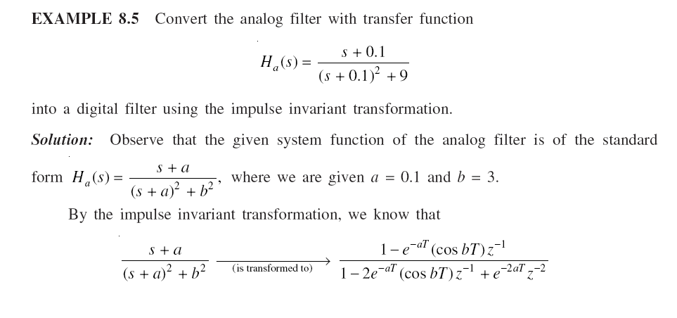

Slide 6
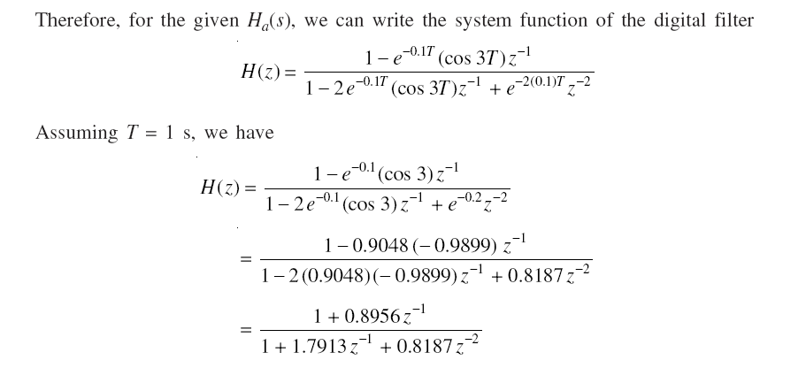

Slide 7
For a system function H(s) to be stable
a. The zeros lie in left half of the s plane b. The zeros lie in right half of the s plane c. The poles lie in left half of the s plane d. The poles lie in right half of the s plane

Slide 8
c

Slide 9
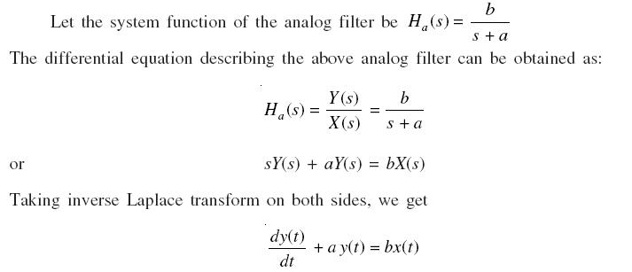
IIR Filter using Bilinear Transformation

Slide 10
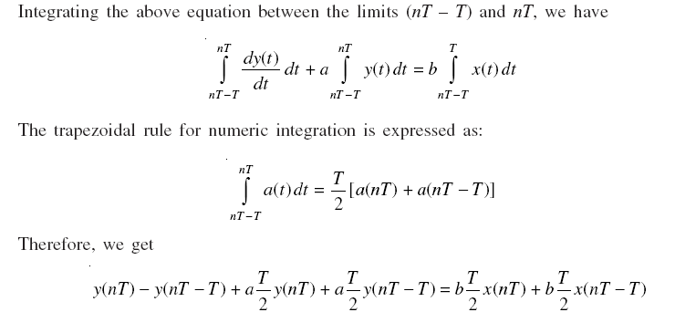

Slide 11
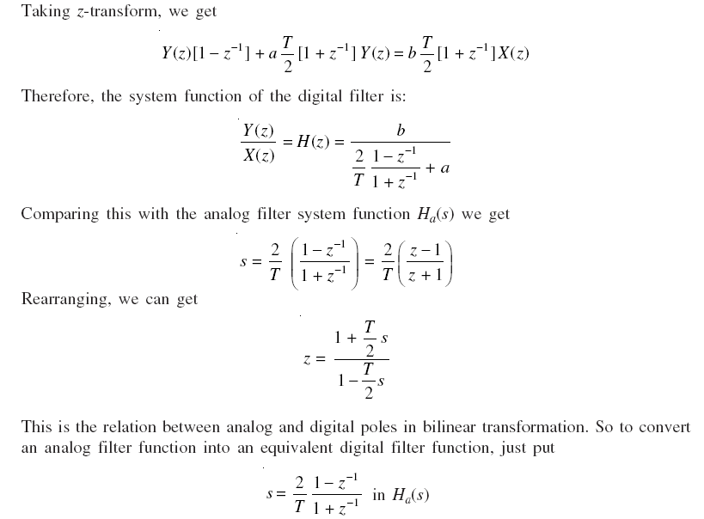

Slide 12
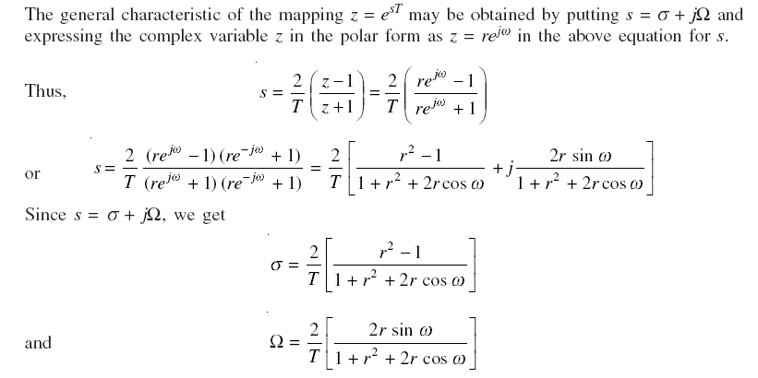

Slide 13
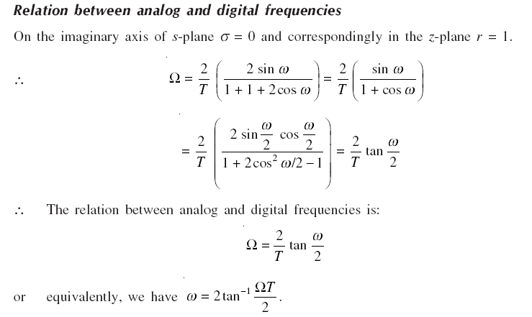

Slide 14
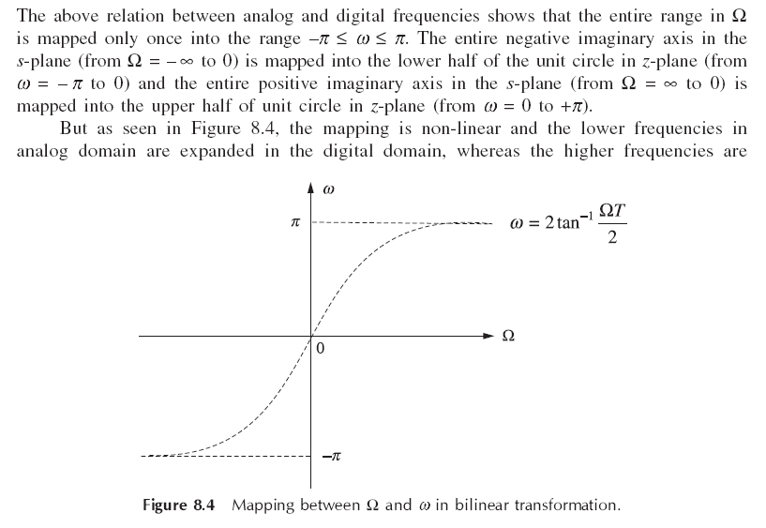

Slide 15
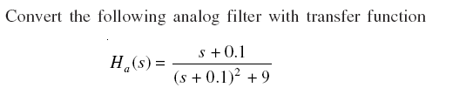
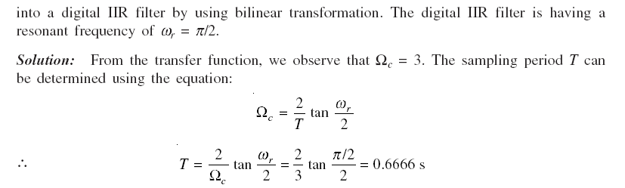

Slide 16
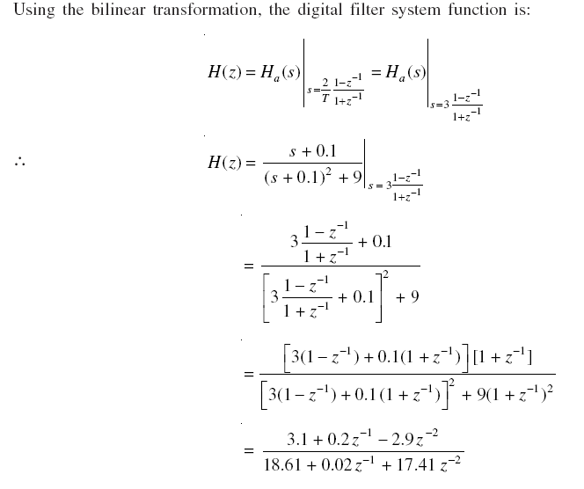

Slide 17
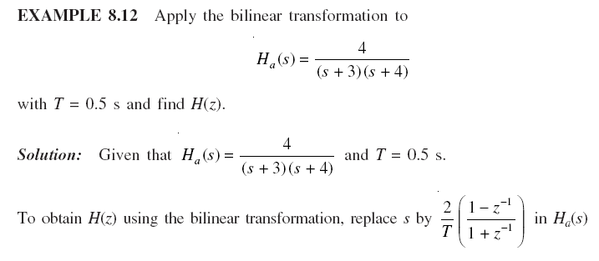

Slide 18
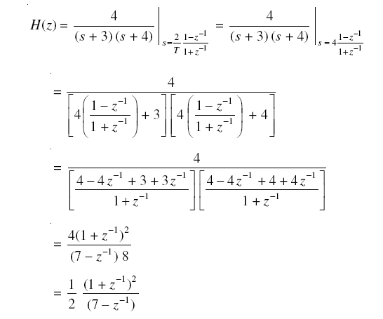

Slide 19
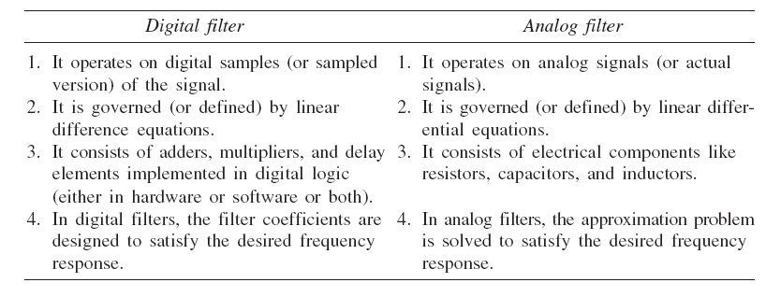

Slide 20
Bilinear Transformation is used for transforming an analog filter to a digital filter.
a) True b) False

Slide 21
A

Slide 22
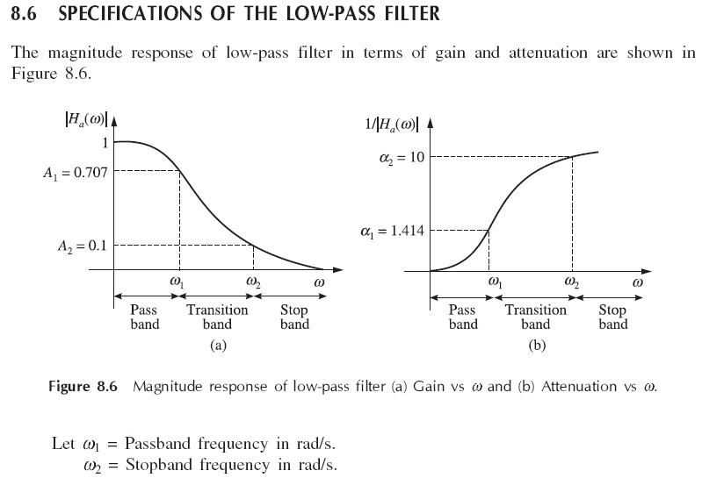

Slide 23
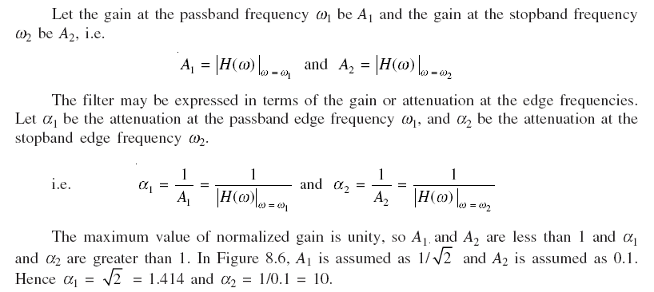

Slide 24
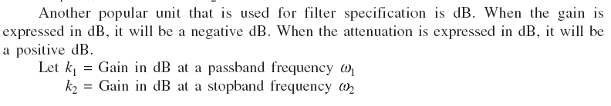
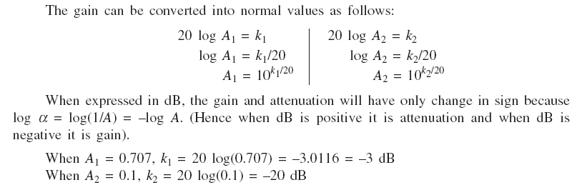

Slide 25
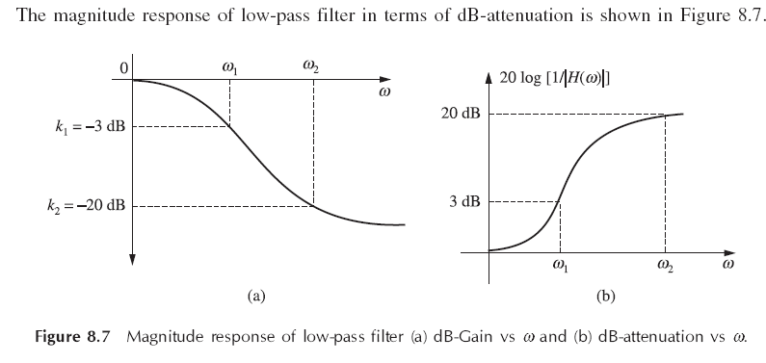

Slide 26
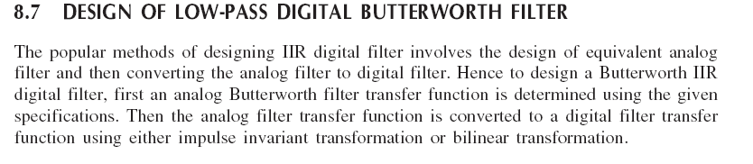

Slide 27
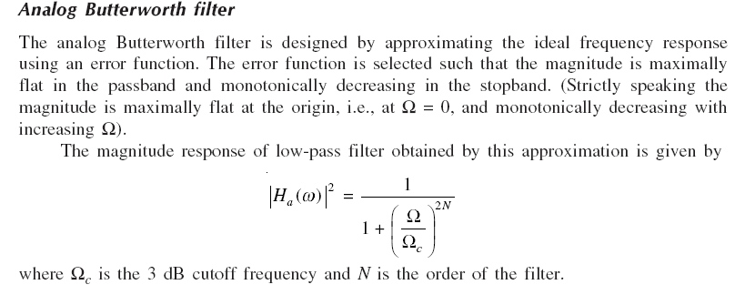

Slide 28
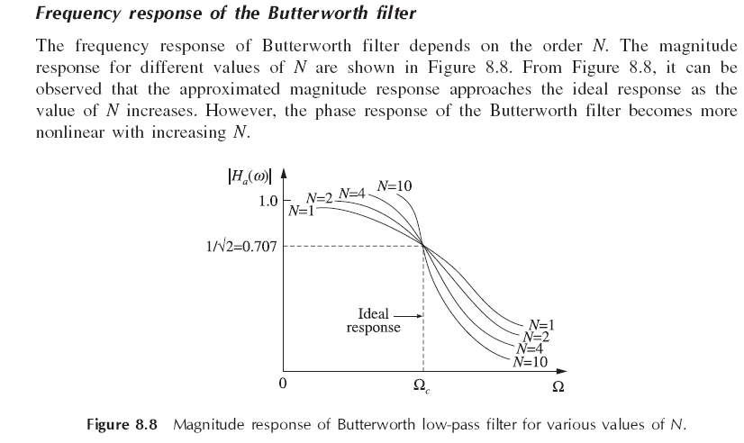

Slide 29
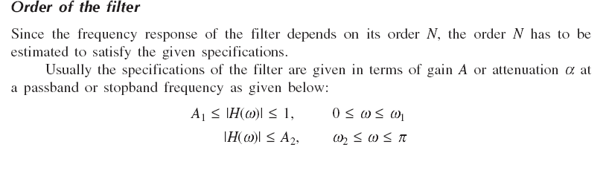

Slide 30
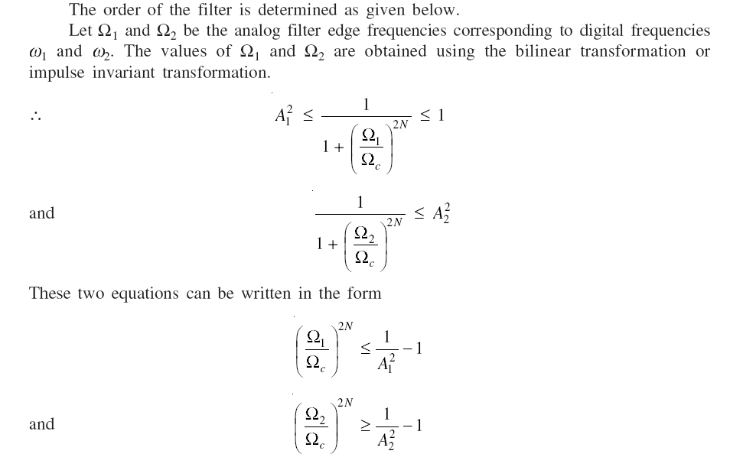

Slide 31
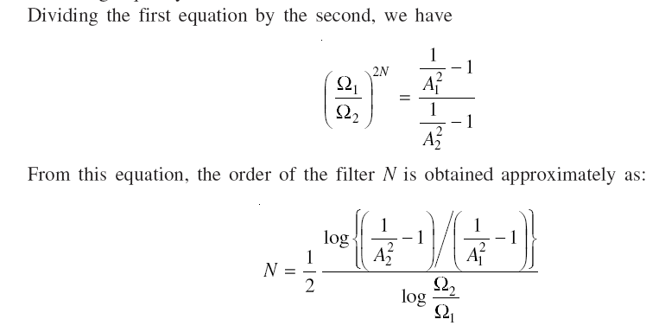

Slide 32
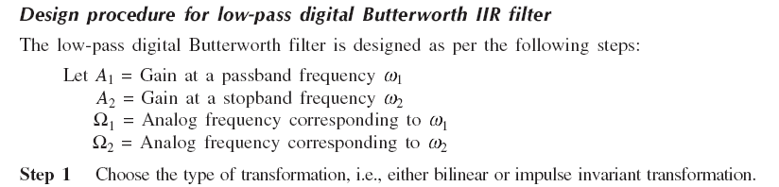

Slide 33
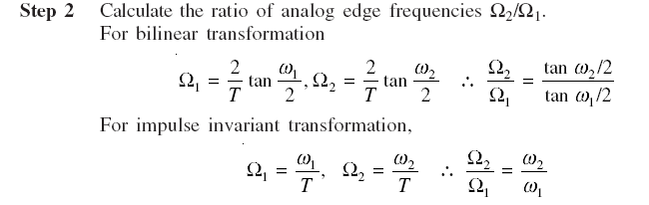

Slide 34
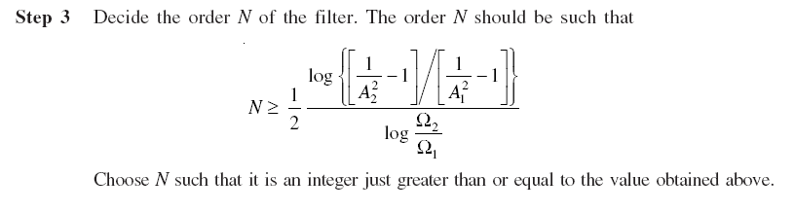

Slide 35
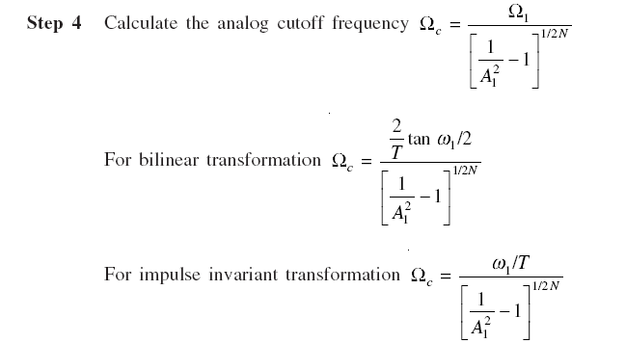

Slide 36
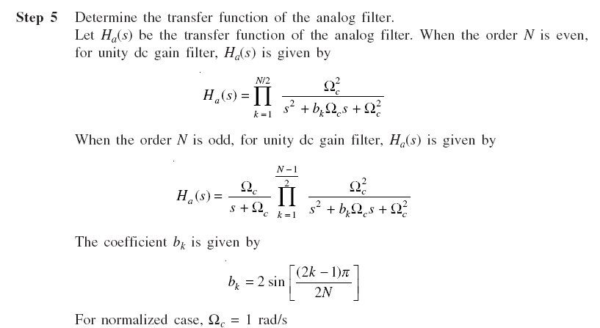

Slide 38
Which of the following rule is used in the bilinear transformation?
a) Simpson’s rule b) Backward difference c) Forward difference d) Trapezoidal rule

Slide 39
D

Slide 40
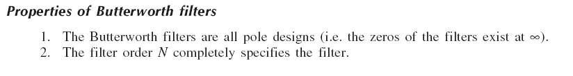
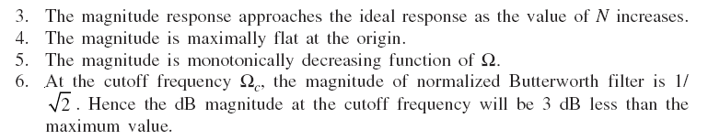

Slide 41
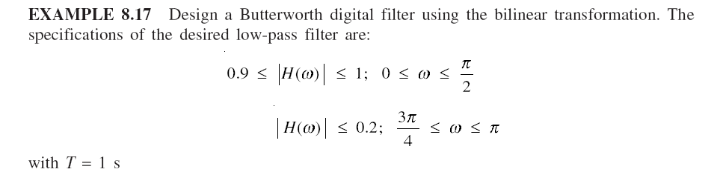

Slide 42
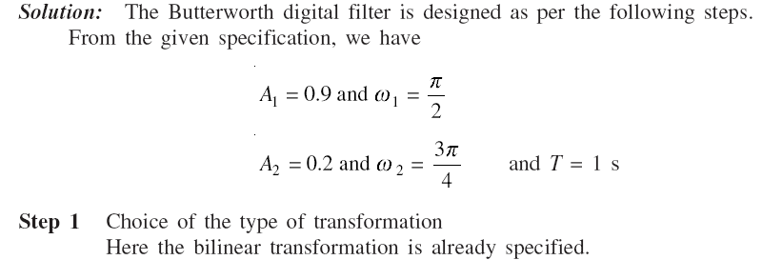

Slide 43
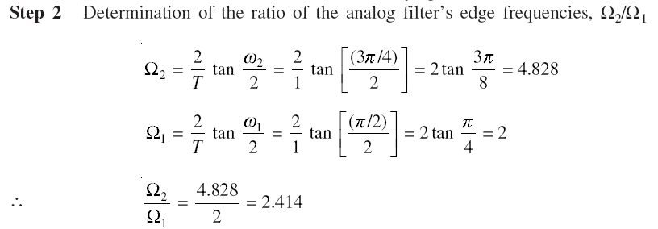

Slide 44
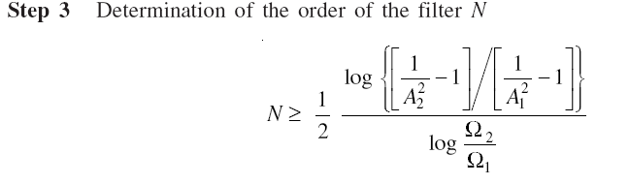
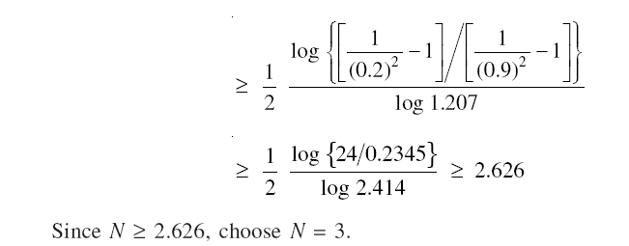

Slide 45
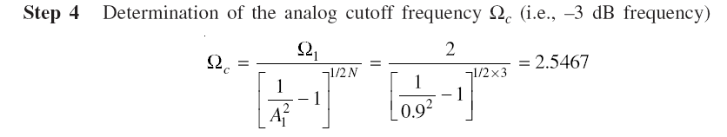

Slide 46
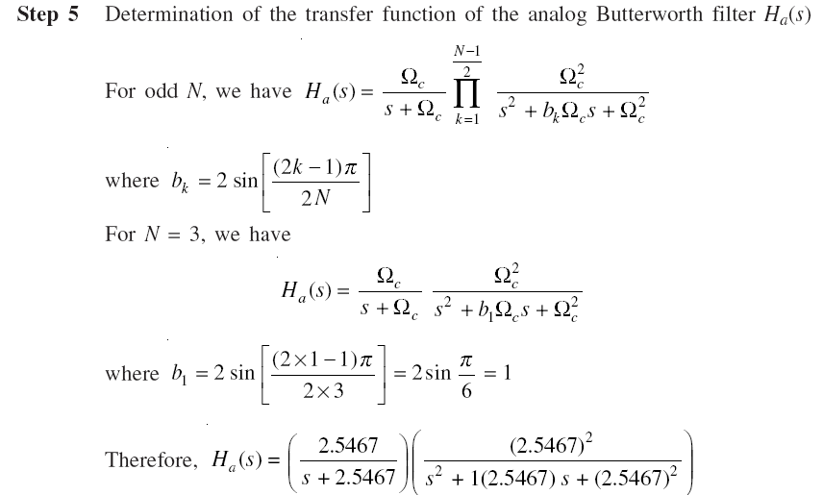

Slide 47
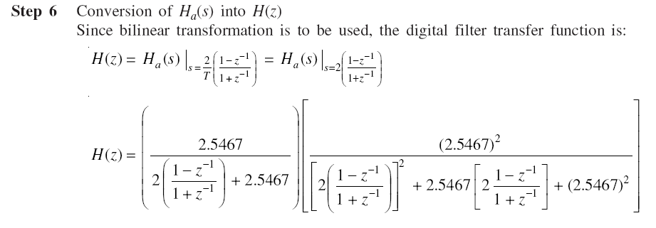

Slide 48


